Slide 1



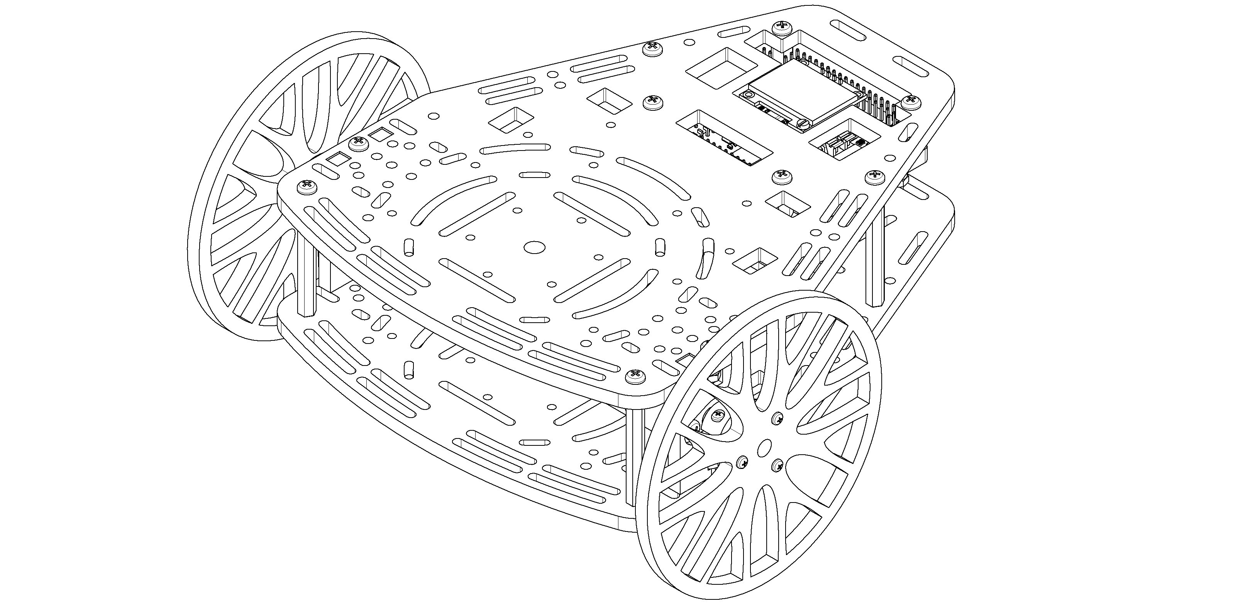
The PuzzleBot
Hardware, firmware, software, and simulation

Slide 2
Schedule
What is a PuzzleBot?
Puzzlebot assembly, setup and configuration

Slide 3
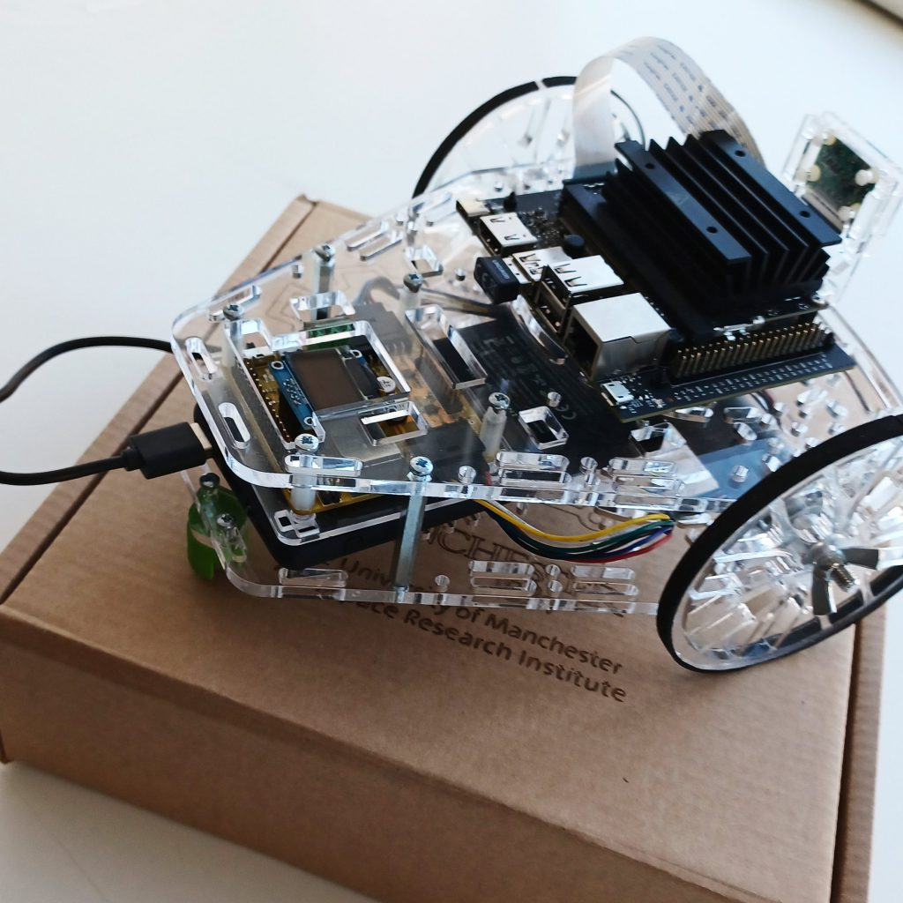
Puzzlebot: Jetson Edition
NVIDIA Jetson Nano
For AI and computer vision
Raspberry Pi Camera
GPIO Arrays
Expansion possible via the
Jetson or the Hacker Board
Hacker Board
For low-level control algorithms

Slide 4
The PuzzleBot
High Level Computing units (RPi, NVIDIA computing units, Laptop, …)
Servo Motors
GPIO
Sensors
Graphic Display
Serial
or Wi-Fi
Puzzle-Bot Control Unit
Left
Encoder
Right
Encoder
Key
Data Signals
Power
Motor Signals
Optional connection
External Power Supply (5 V, 3 A)
(not included)
Wi-Fi / Bluetooth Module (Built-in)
Motor driver
Left Motor
Right Motor
Notes:
Here is a basic block diagram of the puzzlebot
Power can be provided via a USB power bank or an external 5V power supply
High level control algorithms are programmed in the high level compute unit, and control signals can be communicated to the robot via WiFi or USB Serial
Low level – realtime – on the Hacker Board
High level – AI – Real-time not necessary

Slide 5
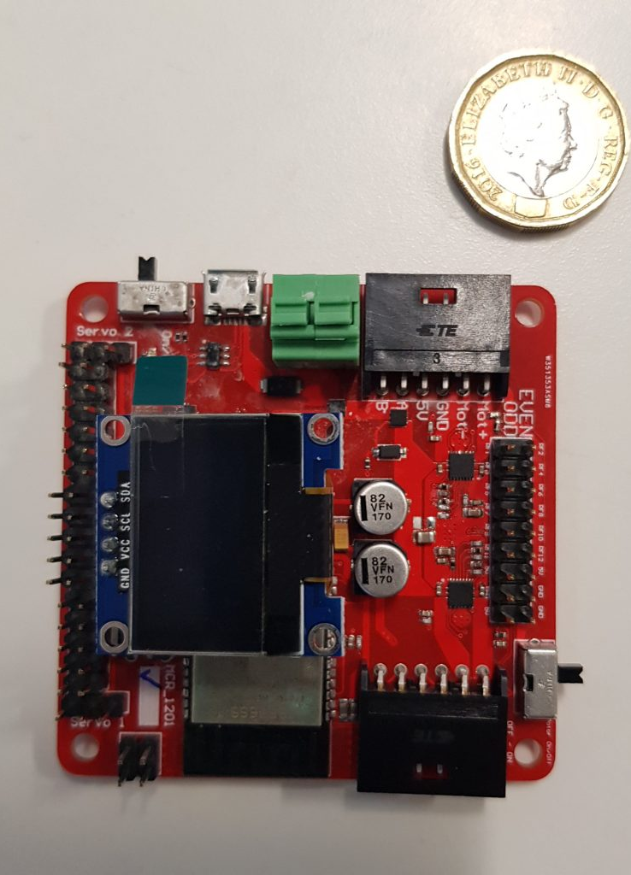
The Hacker Board
ESP32-based Microcontroller
Xtensa dual-core 32-bit LX6 microprocessor
520 KB of SRAM
WiFi & Bluetooth
DC-DC Converter
Motor Driver
0.96” I2C LCD Display
Notes:
Note: Mexico course has V1, but the new robots will be V2
For control of low level, low power components such as motors and encoders
DC-DC convertor provides the voltages necessary for all onboard components
Screen by default displays information such as motor speeds, sonar distance, and connection details

Slide 6
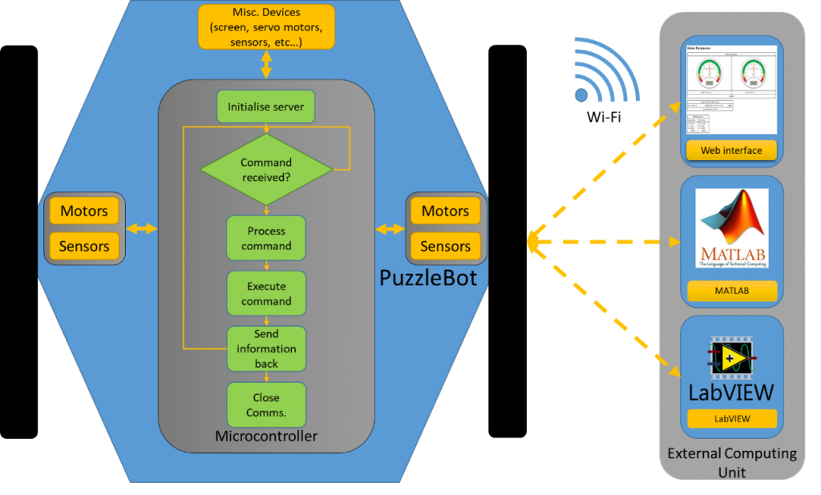
The Hacker Board
Preprogramed firmware including basic control, sensing, and communication libraries
Two programming configurations:
Standalone Configuration
External-Control Configuration
Notes:
Standalone Configuration:
The Hacker Board is programmed directly, making use of the provided libraries to interface with other hardware
This is done using Arduino because it is very popular, however other options (such as Espressif’s system)
External-control Configuration: Control is provided by an external computer, with communication achieved via WiFi or Serial.
All the low level interaction with peripherals is abstracted away
Control algorithms can therefore be tested and implemented with ease
Simple controls can be sent from a webpage, and more complex algorithms can be implemented in MATLAB or labView (python coming soon). MATLAB (and soon python) feature simulations of the puzzlebot, enabling algorithms to be tested before being implemented on the real robot.
In this course, the external compute unit will be the NVIDIA Jetson Nano. Combined with the raspberry pi camera, this setup enables basic control such as line following along with the use of AI for object recognition and identification.
As well as communicating with the hackerboard using ROS, the jetson can communicate with an external PC to receive commands, and could be configured to communicate with other robots for multi-agent control

Slide 7
Updating the firmware
Plug in your PuzzleBot. Note the name of the Wi-Fi network. It will be of the form “PuzzlebotXXX” where XXX is a number.
Download the latest firmware from the link below
https://github.com/Manchester-Robotics/puzzlebot-firmware-release
Mac & Linux: Open a terminal inside the relevant folder, and run ./FirmwareFlash.sh
Windows: double click “FirmwareFlash.bat”.
If a PuzzleBot is connected, the flashing process will start
It will prompt you for a Network SSID and Password. The SSIDs must be unique, so it is recommended to use the same one that was on your PuzzleBot when it arrived
Notes:
Standalone Configuration:
The Hacker Board is programmed directly, making use of the provided libraries to interface with other hardware
This is done using Arduino because it is very popular, however other options (such as Espressif’s system)
External-control Configuration: Control is provided by an external computer, with communication achieved via WiFi or Serial.
All the low level interaction with peripherals is abstracted away
Control algorithms can therefore be tested and implemented with ease
Simple controls can be sent from a webpage, and more complex algorithms can be implemented in MATLAB or labView (python coming soon). MATLAB (and soon python) feature simulations of the puzzlebot, enabling algorithms to be tested before being implemented on the real robot.
In this course, the external compute unit will be the NVIDIA Jetson Nano. Combined with the raspberry pi camera, this setup enables basic control such as line following along with the use of AI for object recognition and identification.
As well as communicating with the hackerboard using ROS, the jetson can communicate with an external PC to receive commands, and could be configured to communicate with other robots for multi-agent control

Slide 8
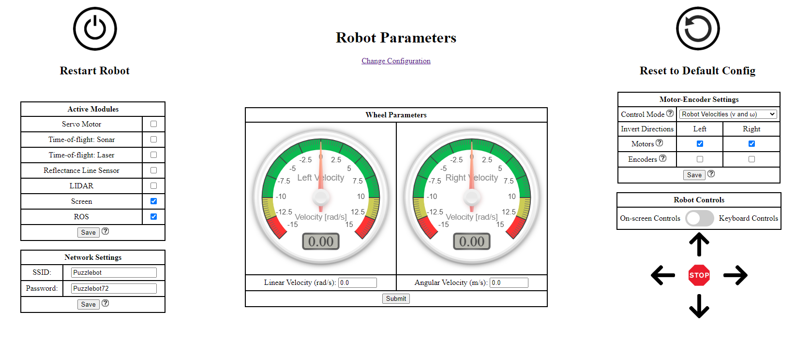
The Webpage
Connect to the WiFi Network displayed on the Hacker Board
Go to 192.168.1.1 in a browser
Notes:
Explain functionality of webpage, how to control wheels and read speed, that it can be used to test the hardware and debug problems
Modules should be deactivated when not in use to save processing power
Updating the network settings should not be necessary much, but it is important that you keep a unique SSID when operating multiple robots in the same room. If you upgrade the firmware, you will need to change the SSID back, otherwise it will be saved as the default.
3 Control modes
1 – Send v and ω, the linear and angular velocities of the whole robot
2 - Send ωr and ωl, the velocities of the left and right wheels
3 – Send pwmr and pwml, the pwm values for the left and right motors (between 0 and 1)
Inverting motors and encoders: this is to account for differences in the mounting of motors. To check this, put the motors in PWM mode.
If a positive PWM is entered, but the motor moves backwards, invert the motor.
If the motors moves forwards, but the speed dial reads negative, invert the encoder.
It may be necessary to invert both, neither, or just one.
Mini Task
Navigate to the webpage
Read the speed of the wheels (by manually rotating them)
Set the speed of the wheels
Use the on-screen controls or the keyboard to remotely operate the robot
Robot Should be lifted off the ground

Slide 9
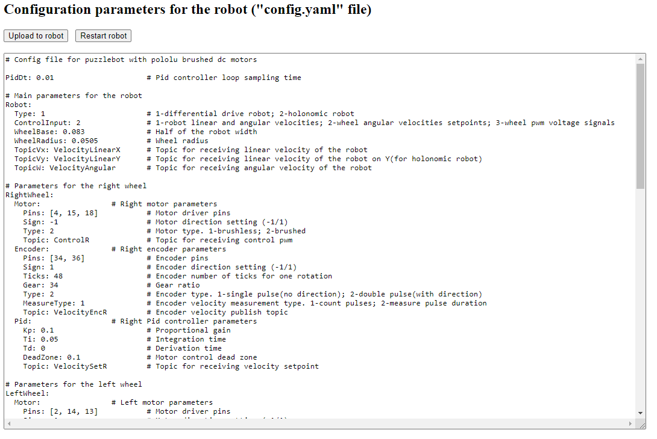
The Config
Now visit 192.168.1.1/config
Notes:
This file allows the parameters of the firmware to be set by the user.
Other key Parameters:
Robot geometry
Pins for hardware (do not need changing except between hacker-board updates)
PID constants for the internal controllers (explain that control modes 1 and 2 use an internal PID controller to set the PWM sent to the motor)
Webpage parameters
Activation values for hardware and software features (such as ROS/sonar/Lidar/etc)
For the change to take effect, click “upload to robot”

